Slide 1
SATS revision guide
Spelling, Grammar, Punctuation and Reading

Slide 2
Spelling

Slide 5
Punctuation

Slide 6
Name | Symbol | Use | Example
Full stop | . | To finish a sentence. | He ran home.
Commas | , | To separate items in a list After a subordinate clause at the start of a sentence After a fronted adverbial
Exclamation Mark | !
Colon | :
Semi-colon | ;

Slide 7
Punctuation | Symbol | Use | Example
Semi-colon | ; | To add extra information
Apostrophe | ‘ | For possession For contraction
 | -- () ,-,
Hyphen | -
Dash | -
Speech marks | “…….”
Ellipses | …

Slide 8
Grammar

Slide 9
Word classes
Type | Use | Example
Adjective | Describes a noun
Verb | An action
Noun | A person, place or thing
Noun – common | People or things
Noun – proper | Person’s name, place name, months/days of the week
Noun – concrete | Something that can be touched, smelled, heard or tasted
Noun – abstract | Ideas, qualities, conditions
Noun – collective | A group pf people or things

Slide 10
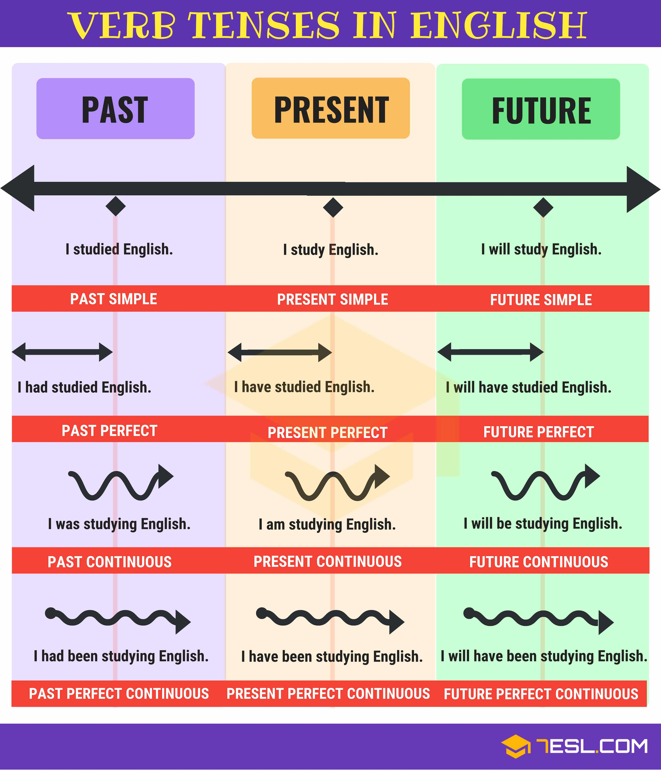
Verb tenses

Slide 11
Sentence Types

Slide 12
Sentences - Clauses
All sentences
CAPITAL LETTER | Subject | Verb | Punctuation . ? ! …
The | child | ran | .

Slide 13
Sentences – simple sentence
Subject | Verb

Slide 14
Sentences – Compound sentence
Simple sentence | Co-ordinating conjunction (FANBOYS) | Simple sentence

Slide 15
Sentences – Complex sentence
Main clause at the start of the sentence.
Subordinate clause at the start of the sentence.
Main clause | Subordinating conjunction | Subordinate clause
Subordinating conjunction | Subordinate clause | Comma , | Main clause

Slide 16
Active and Passive voice
Active voice
Passive voice
Subject | Verb | Object | Punctuation
Object | Verb | Subject | Punctuation

Slide 17
Speech – direct speech
“ Opening speech marks | Capital Letter | The exact words spoken | . , … ? ! Punctuation | “ Closing speech marks | Reported phrase – who is speaking / how it is said (optional)

Slide 18
Reading

