Slide 1

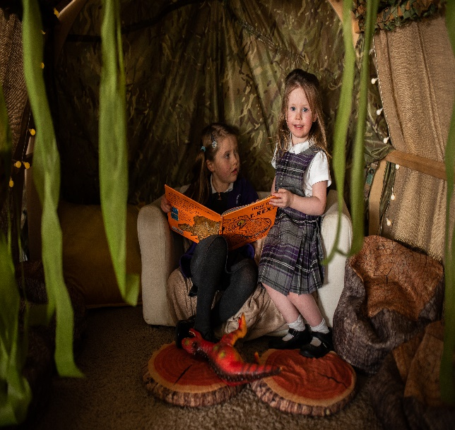
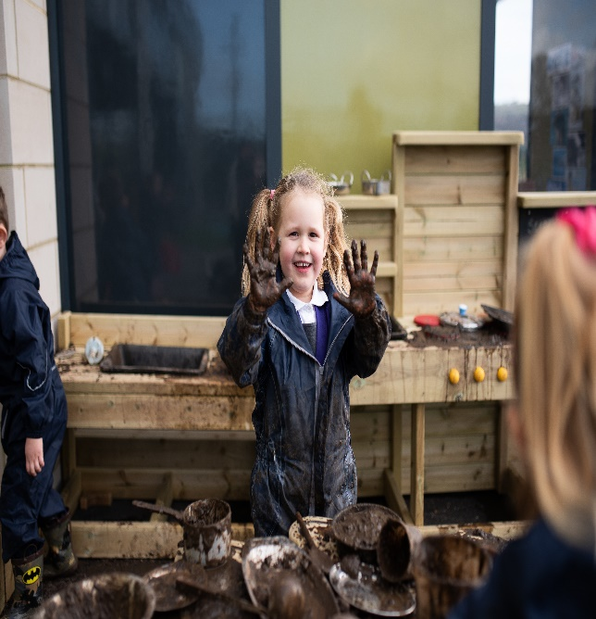
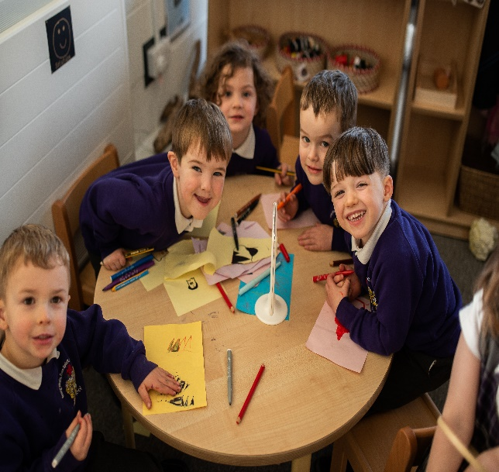

Silsden Primary School Nursery September 2025
Are you looking for a Pre-School Nursery for September 2025?
At Silsden Primary School our Nursery provides a warm, nurturing, and stimulating environment where your child can grow, learn, and thrive.
Our experienced and dedicated staff are passionate about early childhood education and committed to helping every child reach their potential in a safe, fun, and creative setting.
Silsden Primary School warmly invites you to our upcoming Open Days!
Visit our Nursery Provision at any of the dates and times listed below – there is no need to book.
There will be a chance to explore our wonderful setting and meet our Nursery Teacher and staff, who will be able to answer any questions that you may have.
Thursday 30th January at 9:45am and 2pm
Thursday 27th February at 9:45am and 2pm
www.silsdenprimary.co.uk

