Slide 1
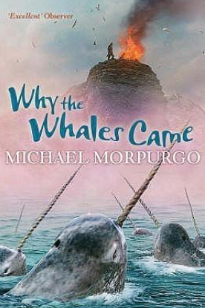


Year 4 Learning Leaflet
DT:
In this cross-curricular unit, pupils combine science and design & technology skills to create a working model of a lighthouse using recycled materials. They explore how electrical circuits power lights and how design can withstand environmental challenges, while developing creativity, problem-solving, and sustainability awareness
.
Dive into the Deep
This unit introduces children to the world’s oceans, exploring their physical features, ecosystems, and importance to life on Earth. Pupils develop geographical, scientific, and literacy skills through engaging activities, research, and creative tasks.
English
In this unit, pupils explore The Song of the Dolphin Boy story, focusing on the ocean and marine life. They use the story as inspiration to write persuasive letters addressed to humans, urging them to protect the ocean. The unit develops reading comprehension, persuasive writing skills, and environmental awareness.
DT:
The Internet- computing systems and networks. The world wide web. How honest, accurate and reliable information is.
.
Maths: Multiplication and Division
These units develop pupils’ fluency, reasoning, and problem-solving skills with multiplication and division. They build on prior knowledge, focusing on times tables, formal methods, and real-life problem contexts.
.
Don’t forget!
Times Table Rock Stars and Spelling Shed - These logins have been sent home.
Regular Reading— Please ensure reads are recorded in reading journals
Creative Homework Tasks—Please bring these in as soon as they have been completed, as it is amazing to see the children's hard work and be able to display these in school.
Science
This unit introduces pupils to electricity and how it flows through circuits. They explore different components, learn to construct simple circuits, and understand how electricity powers everyday devices. The unit combines hands-on experiments, problem-solving, and scientific investigation.
PE
4A- Gymnastics and Netball
4H- Gymnastics and Ball Skills
4T- Climbing and Ball Skills
RE -.’What is the most significant part of the Christmas Story for Christians today?
French-.’I am learning French’ (all about France)
Young Minds, Free Spirit, Great Future

